Slide 1
Supporting Mobility of Blind Pedestrians
Hauptseminar, Steffen Maurer
Multimodal Interaction, Winter term 2014/15

Slide 2

Motivation
39 million people blind worldwide¹
Wayfinding difficult due to lack of access to signs and landmarks
Going to unfamiliar places nearly impossible without help
Dependence on other people
[1]: WHO Fact Sheet No 282
Picture: public domain

Slide 3
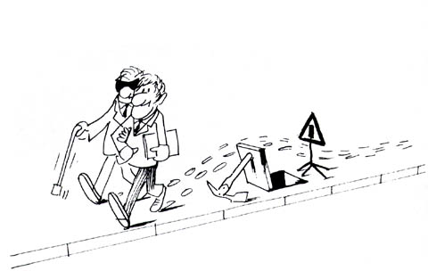
Navigation
Mobility: ability to move safely and avoiding of obstacles¹
Macronavigation²
  distant environment, directions
  Problem: no visual landmarks
Micronavigation²
  Immediate environment, obstacle avoidance
  Problem: obstacle detection
[1]: G. Jansson. Nonvisual guidance of walking. In Perception and control of egomotion, Hillsdale, 1990
[2]: H. Petrie. User requirements for a gps-based travel aid for blind people.
In Proc. of the Conference on Orientation and Navigation Systems for Blind Persons,1995
Top picture: www.automotiveit.eu
Bottom picture: Blinden- und Sehbehindertenverband Tirol, www.tbsv.org

Slide 4
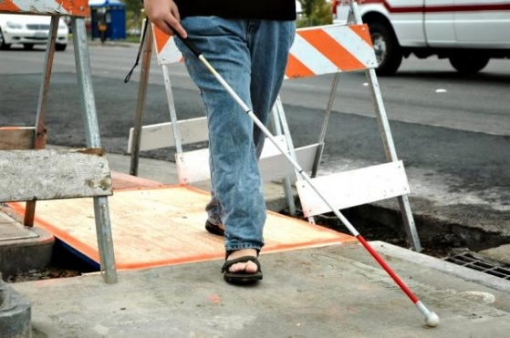
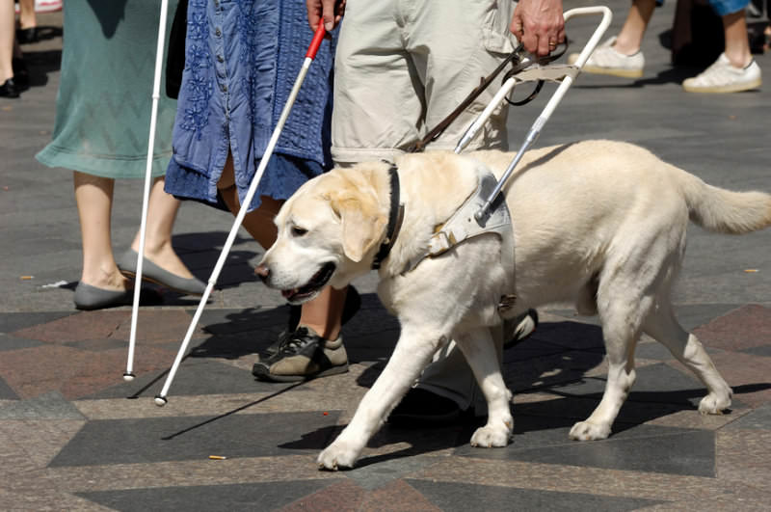
Conventional Methods
Indispensable: Long cane
  Used for micronavigation to detect obstacles
„Intelligent Long-cane“: Guide Dog
  Used for enhanced micronavigation
  and limited macronavigation
  Top picture: Stockphoto / Karin Lau
  Bottom picture: mydog365.de

Slide 5
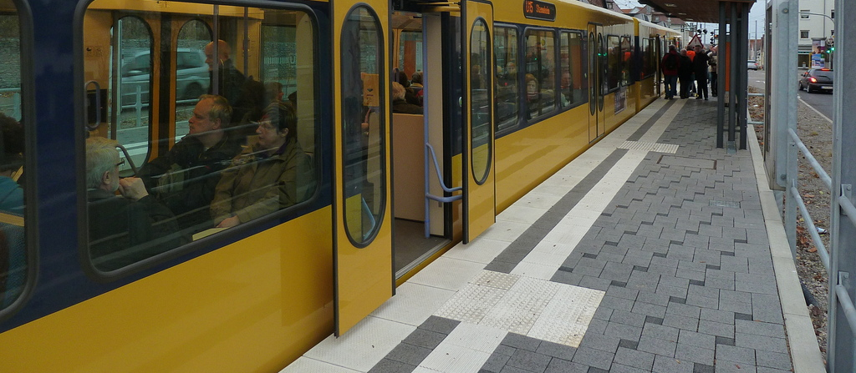
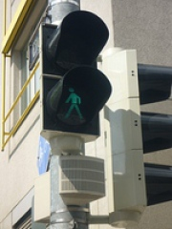
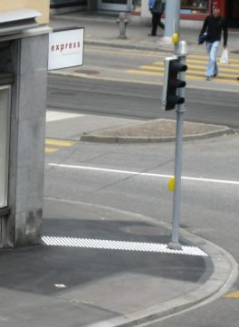
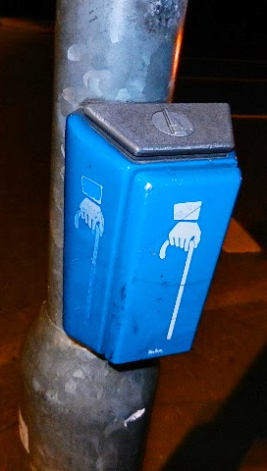
Conventional Methods
Environmental facilities:
  Tactile enhancements
  Auditive signals
Pictures:
Top: Bahnforum Stuttgart, www.bahnforum-s.de, snowtrain
Bottom left: www.nuernberg.de
Bottom middle: www.20min.ch
Bottom right: Kürgen Koll, taximann-juergen.blogspot.de

Slide 6
Modalities
Audio
  Sound may roughly indicate a landmark¹
  Sound reverbed off a wall can be used to travel along a straight line²
  Verbal descriptions and instructions are the best way to guide blind people³
  Signs and advices often have to be read by seeing persons
Problems:
  Easily interfered, especially in urban areas
  Descriptions without visual landmarks,
  but with all relevant features to find the way
[1]: Jansson, „Spatial orientation and mobility of people with visual impairment“, 2000
[2]: Ashmead et al., „Auditory perception of walls via spectral variations in the ambient sound field“, 1999
[3]: Gaunet & Briffault, „Exploring the Functional Specifications of a Localized Wayfinding Verbal Aid for Blind Pedestrians“, 2005

Slide 7
Modalities
Tactile
  Feedback through
    Long cane
    Guide Dog
    Guiding person
    Touching surface (e.g. handrail)
Problems:
  Not everywhere are feelable features on the ground
  Features can be blocked or inaccessible

Slide 8
Modalities
Olfactory
  The smell of a place can serve as a landmark¹
  Smell may give a rough direction
Problems:
  Dependant on wind and temperature
  No precise positioning possible
  Smells can easily be covered by other smells
[1]: Gaunet & Briffault, „Exploring the Functional Specifications of a Localized Wayfinding Verbal Aid for Blind Pedestrians“, 2005

Slide 9
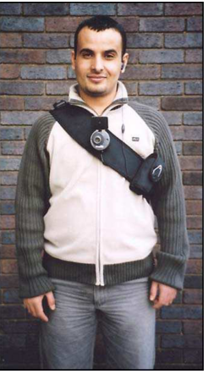
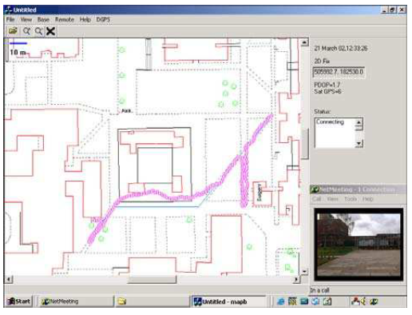
Audio-based Navigation Systems
A system for remote sighted guidance of visually impaired pedestrians
Vanja Garaj et al, Mobility 2007
Blind person wears headset and camera
  Camera footage and GPS signal is streamed to operater
  Operater guides blind person
Study focus was the effect of the video
framerate on obstacle detection
(Operator was tested, not impaired person)
Vanja Garaj et al. “The effects of video image frame rate on the environmental hazards
recognition performance in using remote vision to navigate visually impaired
pedestrians”, Mobility '07. DOI=10.1145/1378063.1378098

Slide 10
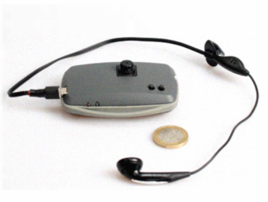
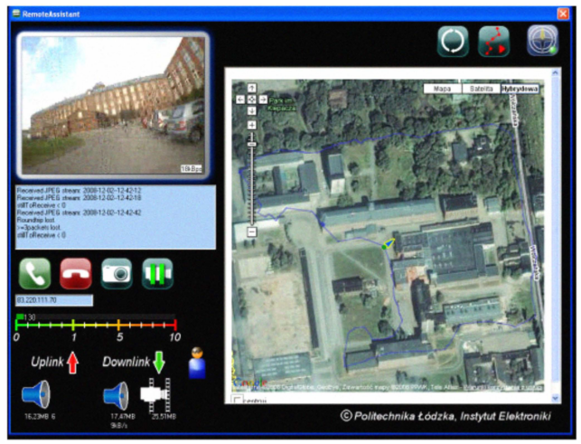
Audio-based Navigation Systems
A remote guidance System for the blind
Przemyslaw Baranski et al, 2010
Same procedure as the previous system
  But using self build device as cheap alternative
  Device connects via Bluetooth to mobile phone
  Using satellite maps
Study with blind participants
Baranski, P.; Polanczyk, M.; Strumillo, P., "A remote guidance system for the blind," Healthcom, 2010
doi: 10.1109/HEALTH.2010.5556539

Slide 11
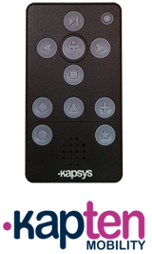
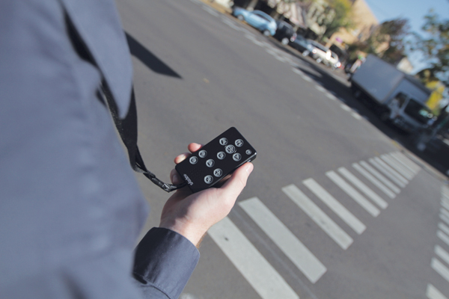
Audio-based Navigation Systems
Kapten Mobility
  Commercial Product by KAPSYS
  Provides audionavigation:
    Pedestrian navigation
    Location description
    Points of interest around the user
    Saveable POIs and adresses
    Musicplayer
  Example of Free Navigation description:
    “On Park St, North West direction,
    arriving on a 3 road intersection.
    At 9 o’oclock: Wild St,
    at 11 o’clock: Berkeley St,
    at 3 o’clock: Queens roundabout.” ¹
[1]: kapsys.com
Pictures: KAPSYS, www.kapsys.com

Slide 12
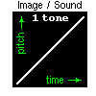
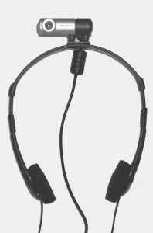
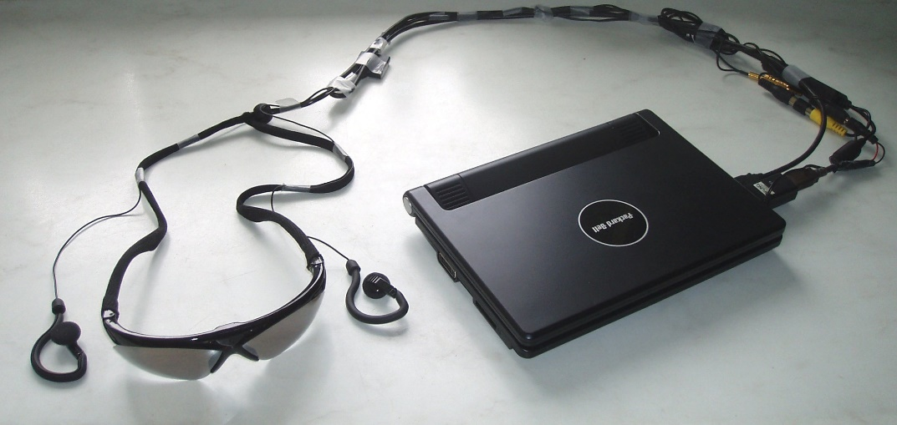
Audio-based Navigation Systems
The vOICe
  www.seeingwithsound.com
Computerprogram, turns visual input to hearable output
  Input via Webcam, TV Card or Screen Streaming
  Mobile through Laptop, PDA or Smartphone (Android App)
Picture with Laptop: Peter Meijer, www.seeingwithsound.com
Other pictures and video: www.seeingwithsound.com

Slide 13

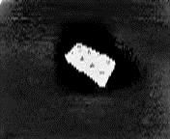

Audio-based Navigation Systems
The vOICe
  www.seeingwithsound.com
Computerprogram, turns visual input to hearable output
  Input via Webcam, TV Card or Screen Streaming
  Mobile through Laptop, PDA or Smartphone (Android App)
Picture with Laptop: Peter Meijer, www.seeingwithsound.com
Other pictures and video: www.seeingwithsound.com

Slide 14
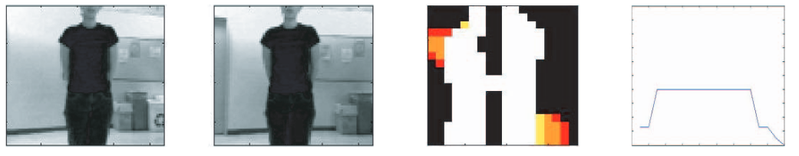
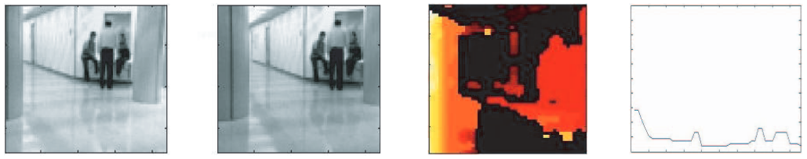
Haptic Navigation Systems
A navigation aid fort he blind using tactile-visual sensory substitution
  Lise Johnson & Charles Higgins
  EMBS 2006
Belt with 14 vibrating motors and stereo camera
  Converts visual input to tactile stimulation
Johnson, L.A.; Higgins, C.M., "A Navigation Aid for the Blind Using Tactile-Visual Sensory Substitution“,
Engineering in Medicine and Biology Society, 2006. doi: 10.1109/IEMBS.2006.259473

Slide 15
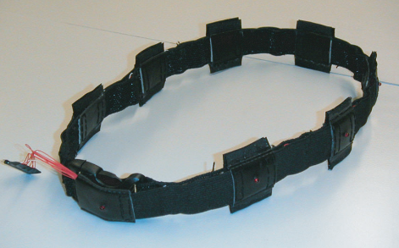
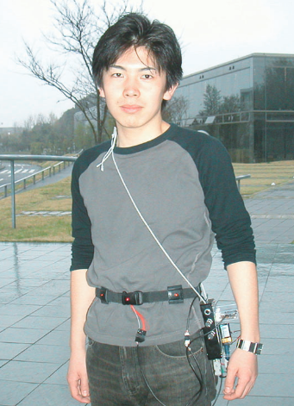
Haptic Navigation Systems
ActiveBelt
  Koji Tsukada & Michiaki Yasumura
  UbiComp 2004
Four Applications:
  FeelNavi: navigation system
  FeelSense: location aware information
  FeelSeek: search of lost properties
  FeelWave: entertainment
K. Tsukada and M. Yasumrua.
Activebelt: Belt-type wearable tactile display for directional navigation.
In Proceedings of UbiComp2004, Springer

Slide 16
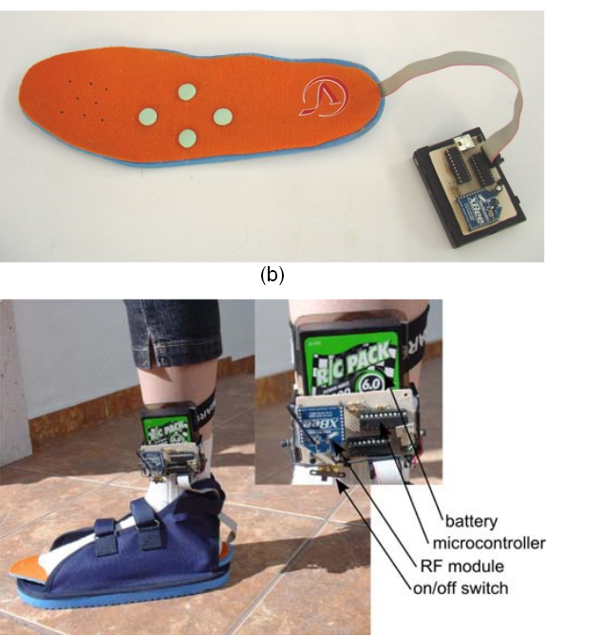
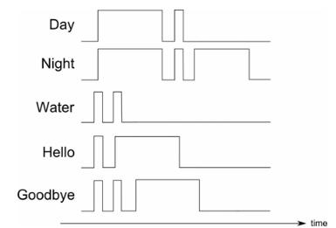
Haptic Navigation Systems
Wearable Electronic Tactile Display for the Foot
  Ramiro Velazquez et al
Four vibrating motors on insole
  High success rates in direction recognition
  during study
  Also recognition of specific patterns possible
Ramiro Velazquez et al. Wearable Electronic Tactile Display for the Foot. Przegląd Elektrotechniczny, 2013, 89. Jg., S. 180-184.

Slide 17
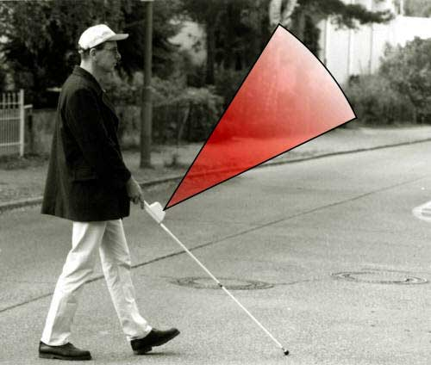
Haptic Navigation Systems
Laser-Langstock
  Commercial product by VISTAC
Obstacle detection for non-ground obstacles
  Recognition via laser
  Feedback by vibration
http://www.vistac.de/lala.shtml
Picture: apa/vistac/regina geisler

Slide 18
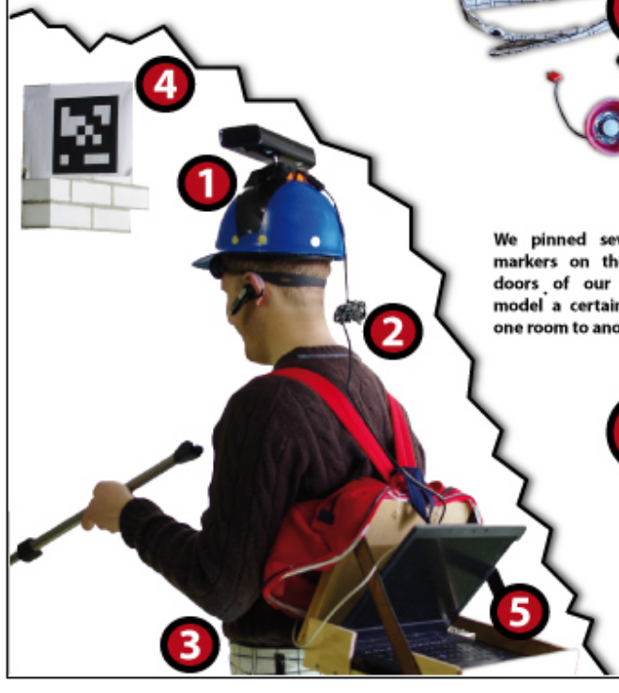
Audio-Tactile Navigation Systems
NAVI
  Michael Zöllner et al
  Project work during HCI course
    Published as Poster on INTERACT 2011
          Head-mounted Microsoft Kinect
          Recognizes Markers and Obstacles
            Audio-output for landmark information
            Obstacle Avoiding via vibrating belt
Zöllner, Michael; Huber, Stephan; Jetter, Hans-Christian; Reiterer, Harald
Proceedings of 13th IFIP TC13 (Interactive Poster), Sep 2011

Slide 19
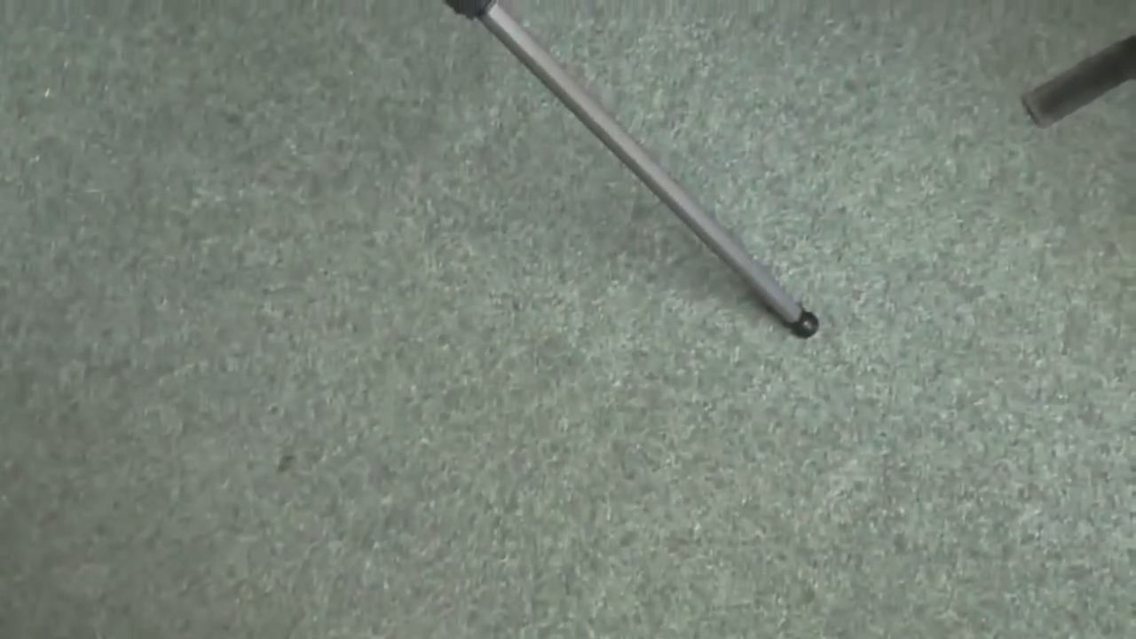
Audio-Tactile Navigation Systems
Zöllner, Michael; Huber, Stephan; Jetter, Hans-Christian; Reiterer, Harald
Proceedings of 13th IFIP TC13 (Interactive Poster), Sep 2011

Slide 20

Audio-Tactile Navigation Systems
Zöllner, Michael; Huber, Stephan; Jetter, Hans-Christian; Reiterer, Harald
Proceedings of 13th IFIP TC13 (Interactive Poster), Sep 2011

Slide 21
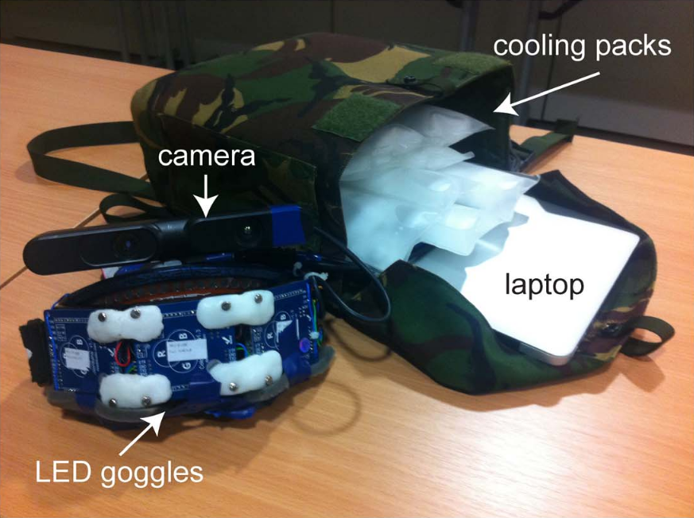
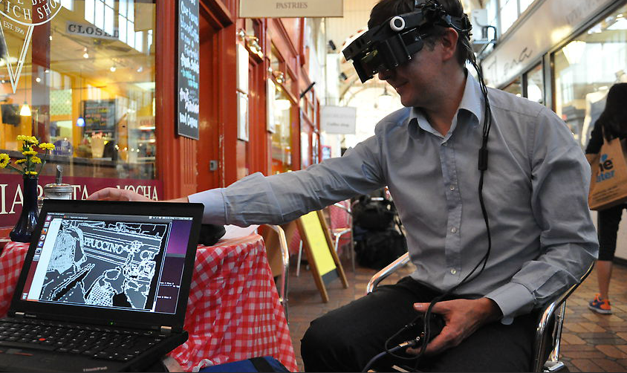
Visual Navigation Systems
Head-Mounted Display to Aid Partially Sighted
  Stephen Hicks et al, 2013
Consits of:
  Head-up display
  Depth-camera
  Portable computer
Produces high contrast
simplification of camera image
Stephen Hicks et al. (2013) A Depth-Based Head-Mounted Visual Display to Aid Navigation
in Partially Sighted Individuals, PLoS ONE 8(7): e67695. doi:10.1371/journal.pone.0067695
Bottom picture: www.ox.ac.uk

Slide 22
Conclusion
Many studies, completed research projects and commercial products available
Interesting and beneficial field of research
Several currently running research projects
But
  No Usability Studies of Technical Assistive Systems in real-life situations available ¹
  Often Systems are developed without taking the methods used by blind people into Account ¹
[1]: Gaunet & Briffault, „Exploring the Functional Specifications of a Localized Wayfinding Verbal Aid for Blind Pedestrians“, 2005

Slide 23
Thank you for your attention

